Slide 1

Classification
Mariem AZOUIGUI

Slide 2



Introduction
Notes:
Data scientists are often tasked with automating decisions for business problems. Is an email an attempt at phishing? Is a customer likely to churn? Is the web user likely to click on an advertisement? These are all classification problems, a form of supervised learning in which we first train a model on data where the outcome is known and then apply the model to data where the outcome is not known. Classification is perhaps the most important form of prediction: the goal is to predict whether a record is a 1 or a 0 (phishing/not-phishing, click/don’t click, churn/don’t churn), or in some cases, one of several categories (for example, Gmail’s filtering of your inbox into “primary,” “social,” “promotional,” or “forums”).
Even in the case of more than two outcomes, the problem can often be recast into a series of binary problems using conditional probabilities. For example, to predict the outcome of the contract, you can solve two binary prediction problems:
• Predict whether Y = 0 or Y > 0.
• Given that Y > 0, predict whether Y = 1 or Y = 2.
In this case, it makes sense to break up the problem into two cases: (1) whether the customer churns; and (2) if they don’t churn, what type of contract they will choose.
From a model-fitting viewpoint, it is often advantageous to convert the multiclass problem to a series of binary problems. This is particularly true when one category is much more common than the other categories.

Slide 3


Basics of probability
P (head ) = ½
P (tail) = ½
4 queens, 52 total cards
P(queen) = 4/52 = 1/13
Notes:
WE all know that when we flip a coin, the prob of getting head or tail is 1 by 2 because there are only two possible outcomes and the chance of getting head or tail is 50% Similarly when you pick a random card, what is the probability or getting a queen
It's very simple, in total we have 52 cards from wich we have 4 queens hence, the proba of getting queen is 4 by 52
Now if you know already that the card picked is a diamond,what is the probability of getting a queen ? This point is called conditional probability

Slide 4
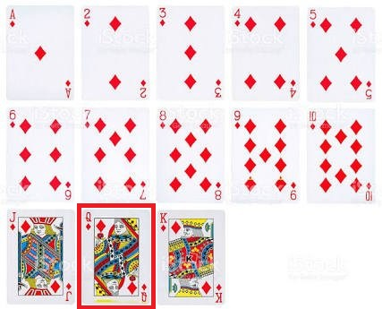
Conditional probability
Total diamonds = 13
Queen = 1
P (queen / diamond ) = 1/13
P (A/B) = Probability of event A knowing that event B has already occured
Notes:
when you know that event A has occured, and you try to predict the probality of event B
By simple intuition the prob here is 1 by 13
So this is how the conditional probability is represented, when we say p of queen slash diamond, we know already that event diamond has already occured and the prob of getting a queen is smth we're calculating, Wich is you know that the card is diamond and you're trying to find the prob of event B which is whether the card is queen or not

Slide 5
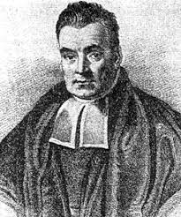
Naïve bayes
P(A|B) = P(B|A)P(A)/P(B)
Notes:
Thomas Bayes gave this famous equation of finding the conditional probability where you can find the prob of A giving event B has occured by knowing some parameters wich are the prior probabilities of A and B and knowing the prob of B giving A
this is a very powerful theorem where we know the prob of some events ( prior )
but we don't know the proba of other events wich are called ( posterior )

Slide 6
Naïve bayes : Theory Application
Three automatic machines produce car parts.
The M1 machine produces 40% of the total parts, the M2 machine 25% and the M3 machine produces 35%.
On average, the percentage of parts not complying with the imposed criteria is 10% for machine M1, 5% for machine M2 and 1% for machine M3.
A part is chosen at random from the total production of the three machines.
It is found that it does not meet the criteria imposed.
What is the probability that it was produced by machine M1?
Notes:
So let's move on to an application of the theory of naive bayes, here we have three ...

Slide 7
Naïve bayes : Theory Application
Notes:
The tree here is a method that help us answer any question of conditional probabilities, in this case we have the ensemble Q that include all machines, as you see each machine has its part of produced car parts, after it for each machine, we have the percentage of the good and bad parts produced.
After we build this tree, the job is 99% done ( in my opinion ) , we just have to apply the naïve bayes theorem using the probability values from the tree.
This way, we can answer to any conditionnal probability problem easily, there is also the array view wich is the same logic of the tree view.

Slide 8
Naïve bayes : Implementation
There are three types of Naive Bayes models: Gaussian, Multinomial, and Bernoulli.
Gaussian Naive Bayes – This is a variant of Naive Bayes which supports continuous values and has an assumption that each class is normally distributed.
Multinomial Naive Bayes – This is another variant which is an event-based model that has features as vectors where sample(feature) represents frequencies with which certain events have occurred.
Bernoulli – This variant is also event-based where features are independent boolean which are in binary form.

Slide 9
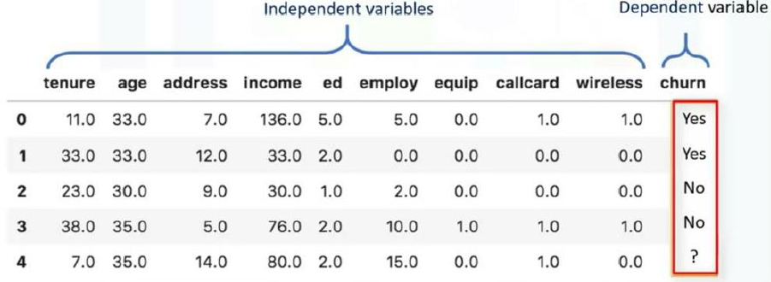
Logistic regression
Logistic regression is analogous to multiple linear regression, except the outcome is binary
Notes:
One of the regression algorithms that can be used for classification is Logistic Regression. (also called Logit Regression) is commonly
used to estimate the probability that an instance belongs to a particular class (e.g., what is the probability that this email is spam?).

Slide 10
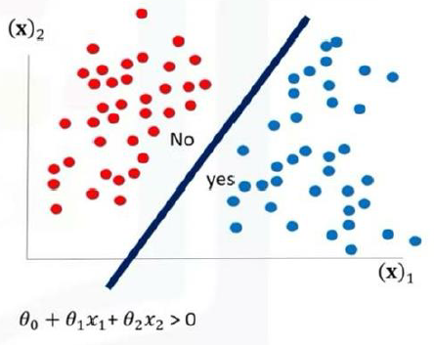
Logistic regression : When to use it ?
If your data is binary : 1/0, YES/NO, True/False
If you need probabilistic results
When you need a linear decision boundary
If you need to understand the impact of a feature
Notes:
2 Predicting the probability of a person having a heart attack 2
Predicting the mortality in injured patients
Predicting a customer's propensity to purchase a product or halt a subscription
2 Predicting the probability of failure of a given process or product

Slide 11
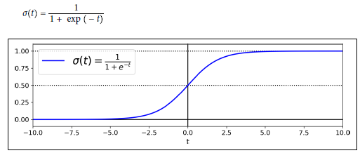
Logistic regression : How does it work ?
Logistic Regression model estimated probability (vectorized form)
p = hθ(x) = σ (θ⊺x)
where : θ⊺x = β0 + β1x1 + β2x2 + ⋯ + βqxq
The logistic—noted σ(·)—is a sigmoid function (i.e., S-shaped) that outputs a number between 0 and 1.
Logistic Regression model prediction
ŷ =
0 if p < 0.5
1 if p ≥ 0.5
Notes:
Just like a Linear Regression model, a Logistic Regression model computes a weighted sum of the input features (plus a bias term), but instead of outputting the result directly like the Linear Regression model does, it outputs the logistic of this result.
Once the Logistic Regression model has estimated the probability p = hθ(x) that an instance x belongs to the positive class, it can make its prediction ŷ easily
In the book, they called it a generalize linear model also, because it's a specific form that uses the logit function with the linear response, there are others functions
that could be combined with the linear one too.

Slide 12
Logistic regression : Implementation
Notes:
Logistic regression is intended for two-class or binary classification problems. It can be extended for multi-class classification but is rarely used for this purpose.
Logistic regression can become unstable when the classes are well separated.
Logistic regression can become unstable when there are few examples from which to estimate the parameters.

Slide 13
Logistic regression : Limitations
Two-Class Problems.
Unstable With Well Separated Classes.
Unstable With Few Examples.
Notes:
Logistic regression is intended for two-class or binary classification problems. It can be extended for multi-class classification but is rarely used for this purpose.
Logistic regression can become unstable when the classes are well separated.
Logistic regression can become unstable when there are few examples from which to estimate the parameters.

Slide 14
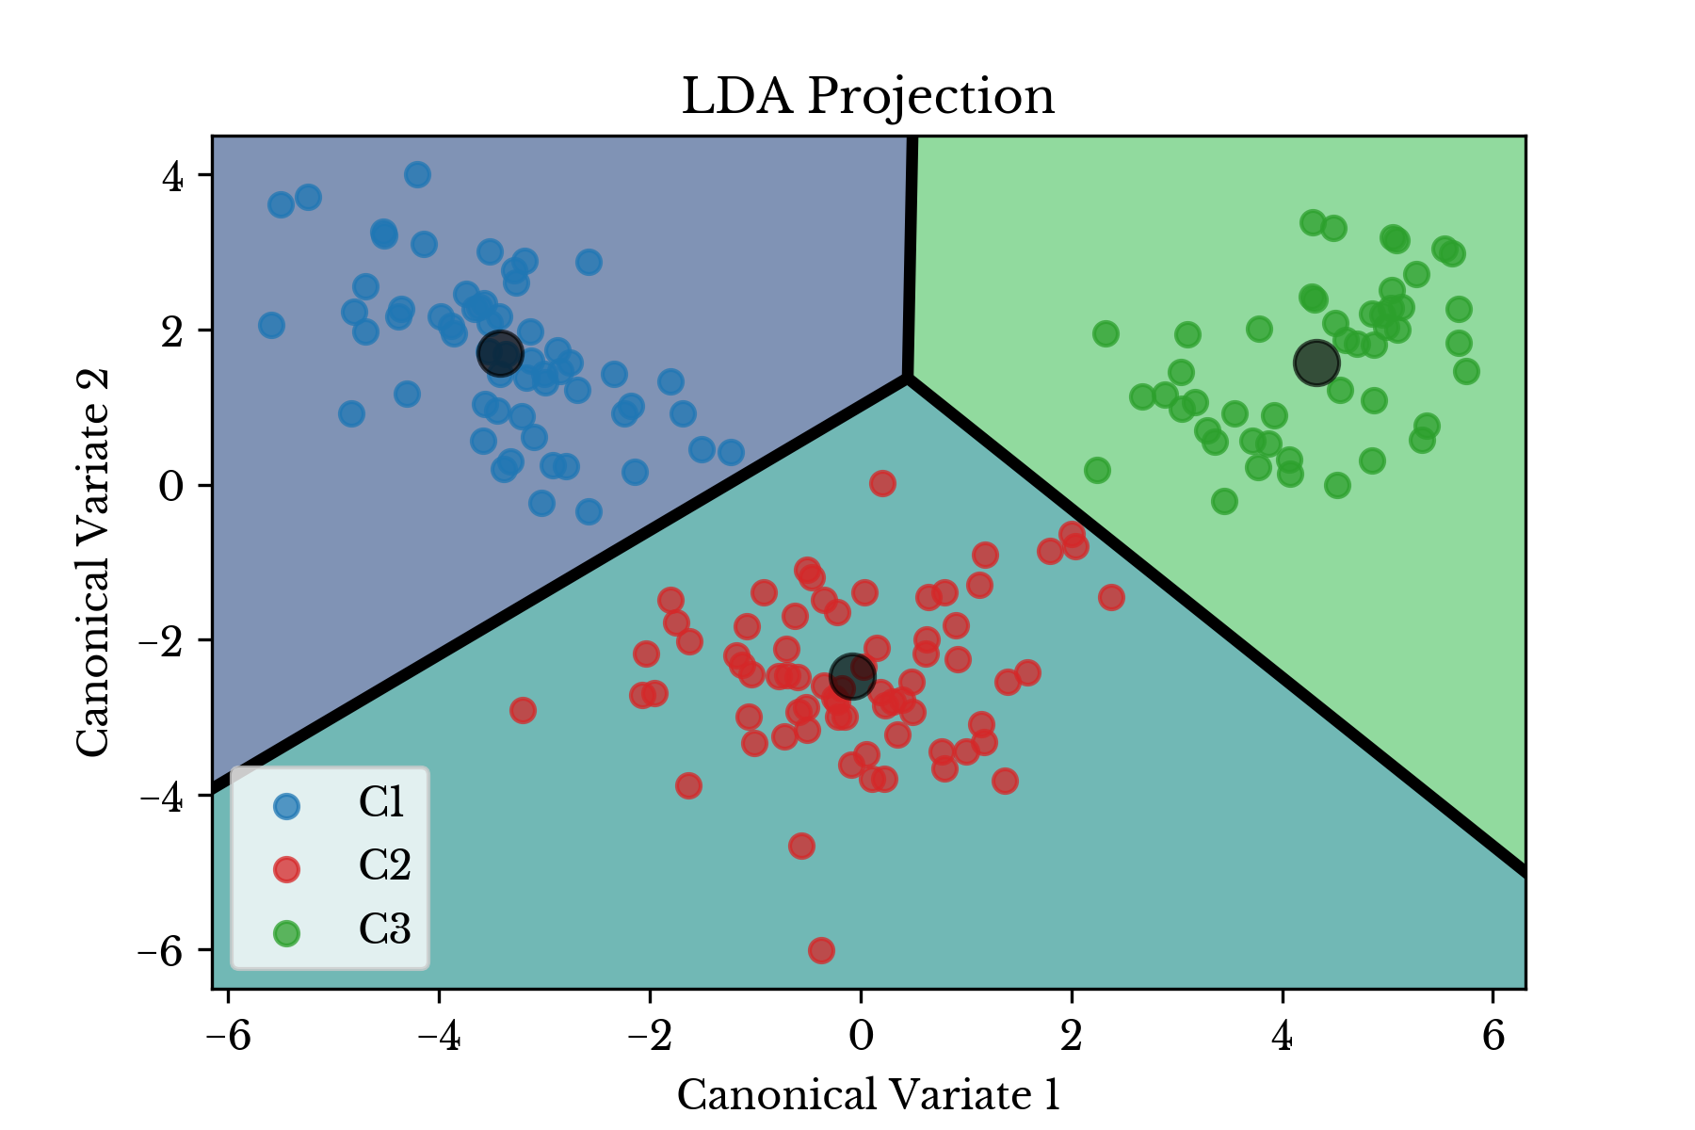
Linear Discriminant Analysis
Earliest statistical classifier; it was introduced by R. A. Fisher in 1936 in an article published in the Annals of Eugenics journal
A classification algorithm, but during training it learns the most discriminative axes between the classes
Notes:
Is a classification algorithm, but during training it learns the most discriminative axes between the classes, and these axes can then be used to define a hyperplane onto which to project the data. The benefit of this approach is that the projection will keep classes as far apart as possible, so LDA is a good technique to reduce dimensionality before running another classification algorithm such as an SVM classifier.

Slide 15
Linear Discriminant Analysis
The main motivations for dimensionality reduction are:
• To speed up a subsequent training algorithm (in some cases it may even remove noise and redundant features, making the training algorithm perform better)
• To visualize the data and gain insights on the most important features
• To save space (compression)
The main drawbacks are:
• Some information is lost, possibly degrading the performance of subsequent training algorithms.
• It can be computationally intensive.
• It adds some complexity to your Machine Learning pipelines.
• Transformed features are often hard to interpret.
Notes:
It consists of statistical properties of your data, calculated for each class. For a single input variable (x) this is the mean and the variance of the variable for each class. For multiple variables, this is the same properties calculated over the multivariate Gaussian, namely the means and the covariance matrix.
These statistical properties are estimated from your data and plug into the LDA equation to make predictions. These are the model values that you would save to file for your model.

Slide 16

Linear Discriminant Analysis : How it works ?
Covariance : measures the relationship between two variables x and z
Fisher’s linear discriminant distinguishes :
Variation between groups, on the one hand, from variation within groups on the other.
Maximizing the “between” sum of squares SSbetween (measuring the variation between groups)
Minimizing relative to the “within” sum of squares SSwithin (measuring the within-group variation).
Notes:
It consists of statistical properties of your data, calculated for each class. For a single input variable (x) this is the mean and the variance of the variable for each class. For multiple variables, this is the same properties calculated over the multivariate Gaussian, namely the means and the covariance matrix.
So to understand how the lda works, we need first to know the covariance
As with the correlation coefficient , positive values indicate a positive relationship and negative values indicate a negative relationship.
Correlation, however, is constrained to be between –1 and 1, whereas covariance scale depends on the scale of the variables x and z
2 Specifically, seeking to divide the records into groups,
3 Linear discriminant analysis (LDA) focuses on
So the idea here is to find the linear combination that maximizes the distances between groups, and minimizes the distances within groups

Slide 17
Linear Discriminant Analysis : Implementation
Notes:
It consists of statistical properties of your data, calculated for each class. For a single input variable (x) this is the mean and the variance of the variable for each class. For multiple variables, this is the same properties calculated over the multivariate Gaussian, namely the means and the covariance matrix.
So to understand how the lda works, we need first to know the covariance
As with the correlation coefficient , positive values indicate a positive relationship and negative values indicate a negative relationship.
Correlation, however, is constrained to be between –1 and 1, whereas covariance scale depends on the scale of the variables x and z
2 Specifically, seeking to divide the records into groups,
3 Linear discriminant analysis (LDA) focuses on
So the idea here is to find the linear combination that maximizes the distances between groups, and minimizes the distances within groups

Slide 18
Thank you for your attention

